Slide 1
Model-based Development of
Embedded Systems
S. Ramesh

Slide 2
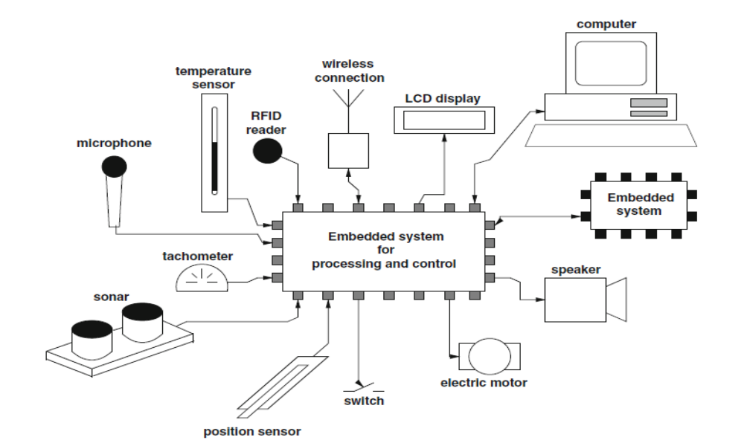
Embedded Systems

Slide 3

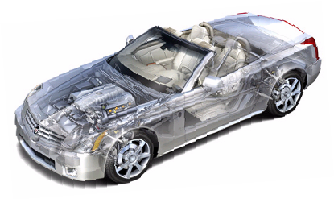
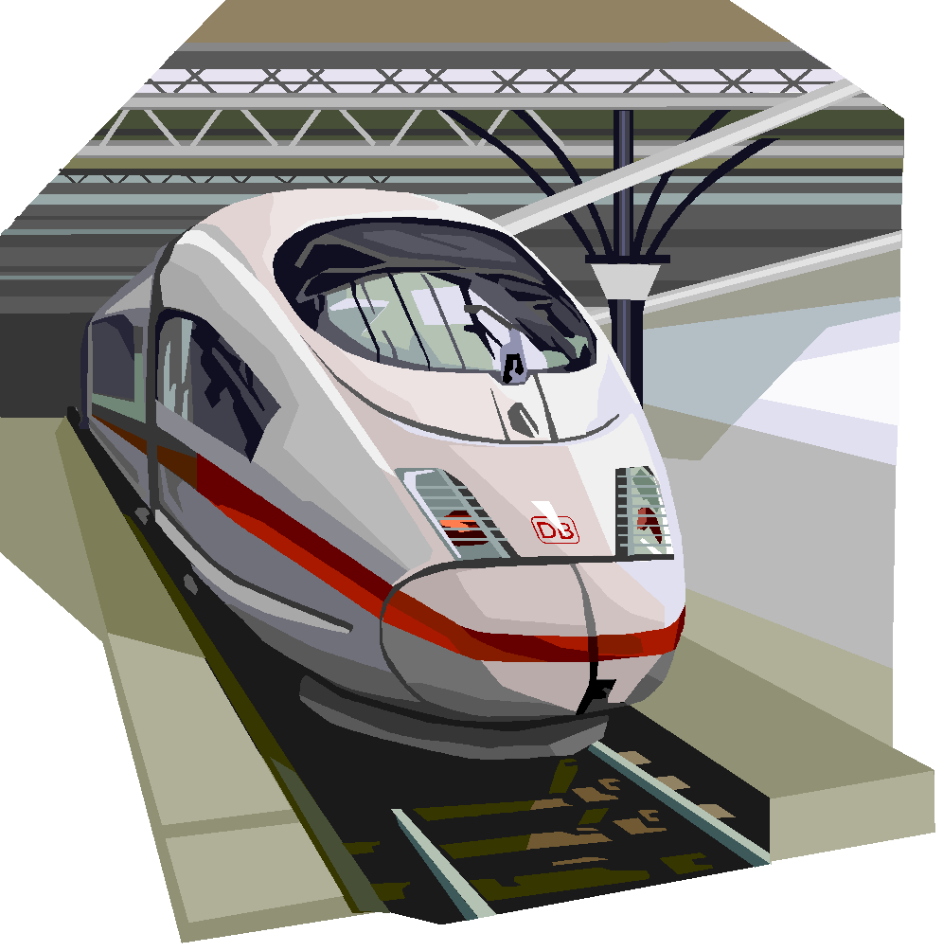
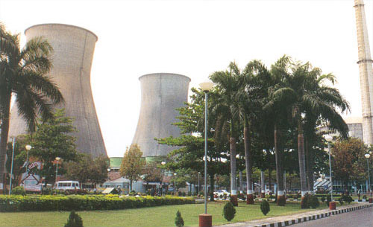
Complex Embedded Systems
Technical Complexity
  Multiple Control Loops
  Non-trivial interaction
  Variety of physical Elements
Variety of para-functional requirements
  Safety-criticality
  Security (in the connected world)
  Explainability (in the AI era)

Slide 4
Development Challenges
Embedded Systems are quite complex
1. Correct functioning is crucial
  safety-critical applications
  damage to life, economy can result
2. They are Reactive Systems
  Once started run forever.
  Termination is a bad behavior.
  Compare conventional computing
(transformational systems)

Slide 5
Development Challenges
3. Concurrent systems
  System and environment run concurrently
  multi-functional
4. Real-time systems
  not only right outputs but at right time
  imagine a delay of few minutes in pacemaker
  5. Hybrid Systems
  Continuous Environment, Discrete Platform

Slide 6
Development Challenges
6. Stringent resource constraints
  compact systems
    simple processors
    limited memory
  quick response
  good throughput
  low power
  Time-to-market

Slide 7
Development Challenges
7. Complex Environments
  Physical Systems
  Multiplicity of elements
    Semantic objects, e.g., road signs, lane markers, other participants and their behaviors
    Extreme variability, e.g., lighting, weather, etc.

Slide 8
System Development
Process of arriving at a final product from requirements
Requirements
  Vague ideas, algorithms, of-the shelf components, additional functionality etc.
  Natural Language statements
  Informal
Final Products
  System Components
  Precise and Formal

Slide 9
System Components
Embedded System Components
  Programmable processors (controllers & DSP and System on Chips)
  Standard and custom hardware
  Concurrent Software
  OS Components:
    Schedulers, Timers, Watchdogs,
    IPC primitives
  Interface components
    External, HW and SW interface

Slide 10
System Development
Requirement Gathering and Documentation
Functional Decomposition
Architecture Selection: Choice of processors, standard hardware
Mapping of functionality to HW and SW
Development of Custom HW and software
Communication protocol between HW and SW
Prototyping, verification and validation

Slide 11
Design Choices
Choices in Components
  Processors, DSP chips, FPGAs, Std. Components
Many different choices in mapping
  Fully HW solution
    More speed, cost, TTM (Time to market), less robust
    Std. HW development
  Fully SW solution
    Slow, less TTM, cost, more flexible
    Std. Micro controller development

Slide 12
Mixed Solution
Desired Solution is often mixed
  Optimal performance, cost and TTM
  Design is more involved and takes more time
  Involves Co-design of HW and SW
  System Partitioning - difficult step
  For optimal designs, design exploration and evaluation essential
  Design practices supporting exploration and evaluation essential
  Should support correctness analysis as it is crucial to ensure high quality

Slide 13
ES Development
Involves both HW and SW development
Both have taken different routes
Fundamentally different
  HW is finite state, HW is tangible
  SW is infinite state, abstract
Development processes converging
  Model based development (MBD)

Slide 14
Software Development
Software crisis (in the seventies)
  Hardware crisis?
Large no. of complex applications
Little experience
Huge gap between requirements and final implementation
Lack of methodologies
Challenge for project managers
Little ways of planning, time-schedule, cost, quality etc.

Slide 15
Software Engineering
Large body of academic and industrial research and experience over 20 years
Emergence of Software Engineering as a discipline
Various Concepts
  Structured Programming, Information Hiding, OOP,
Various methodologies
  Structured Analysis, Jackson System Development,
Different Models of Development
  Water-fall model, Spiral Model, V-cycle
Model-based development methodologies is recent outcome
  RT- UML, ROOM, SCR, RTSAD, ADARTS . . .

Slide 16
HW Development
Transistor Level - Gate Level – Function Block Designs
High Level Design and Synthesis
Hardware Description Languages
  VHDL, Verilog
Fore-runner of Model-based Development
  VHDL, Verilog are modelling languages
Requirement Capture, Modeling and Analysis gaining importance
  Assertion based verification

Slide 17
Classical design methodology
Requirements
Analysis
Design
Implementation
Testing

Slide 18
Development Methodology
Simplified Picture of SW development
  Requirements Capture and Analysis
  Design
  Implementation (coding)
  Verification and Validation
  Bugs lead redesign or re-implementation

Slide 19
Development Methodology
All steps (except implementation) are informal
  Processes and objects not well defined and ambiguous
  Design and requirement artifacts not precisely defined
  Inconsistencies and incompleteness
  No clear relationship between different stages
  Subjective, no universal validity
  Independent analysis difficult
  Reuse not possible

Slide 20
Classical Methodology
Totally inadequate for complex systems
  Thorough reviews required for early bug removal
  Bugs often revealed late while testing
  Traceability to Design steps not possible
  Debugging difficult
  Heavy redesign cost
Not recommended for high integrity systems
  Read embedded systems

Slide 21
Role of Modeling
Models play a fundamental role in complex system design, development & verification
What is a model?
  Mechanism that mimics reality, easy to build, rebuild, analyze & test
  Mathematical or digital representation
  Abstraction of reality – managing complexity
Why models?

Slide 22
Models in the GPT era
Models are fundamental for human understanding & design
  at least that is what we believe
Hard to imagine building such complex systems
Current day AI systems do not (appear to) use models as we understand it.
They are built on knowledge developed using models
Fundamental debate in the AI community
  Brittle, unreliable, versatility

Slide 23
Formal Methodology
A methodology using precisely defined artifacts at all stages
  Precise statement of requirements (Req Models)
  Formal design artifacts (Design Models)
  Formal: Precisely defined syntax and semantics
  Translation of Design models to implementation

Slide 24
Model-based Development
Models are abstract and high level descriptions of design objects
Focus on one aspect at a time
Less development and redesign time
Implementation constraints can be placed on models
Design exploration, evaluation and quick prototyping possible using models

Slide 25
New Paradigm
Executable models essential
  Simulation
Can be rigorously validated
  Formal Verification
Models can be debugged and revised
Automatic generation of final code
  Traceability
The paradigm
Model – Verify – Debug – CodeGenerate

Slide 26
Schematic Diagram
Environment
Plant
Controller

Slide 27
Model based development
Model
Environment Model
Link Model
Plant Model
Link Model
Controller Model
Plant
Controller
Environment
Real System

Slide 28
Virtualization
Large scale modeling efforts underway
Validation moving from `real’ to `virtual’
Most validation to be done in the `lab’
On-road testing uncontrollable and expensive
Variety of situations and conditions can be imagined and simulated at the model level
Real to virtual models

Slide 29
Tools
Several tools - commercial and academic
Classical ones:
  Polis, Metropolis (Berkeley)
  SpecCharts (Irvine)
  STATEMATE, Rhapsody (IBM)
  SCADE, Esterel Studio (Esterel Technologies)
  Simulink/stateflow (Mathworks)
New domain specific languages and simulation tools developed
  dSpace ASM, CARSIM, Carmaker, Carla, Simean (AI)
Modeling and Simulation plays a central role in the develoment

Slide 30
What is a controller
Layers of SW/HW
Different development teams
Integration is a major step
Modeling controllers
  Application modeling
  HW Modeling
Application
Middleware
OS
Basic Software
Hardware

Slide 31
What is a system
Distributed System in general
Plant extended in space
  E.g., Power grid, Road network
Multiple Controllers connected together
Variety of connections, e.g., CAN, Ethernet, Wireless, etc.
Modeling involves creating models for controllers as well their connectivity

Slide 32
Modeling Languages
Models need to be formal
Languages for describing models
High level programming languages (C, C++, SystemC)
Finite State Machines, Statecharts, SpecCharts, Esterel, Stateflow
Data Flow Diagrams, Lustre, Signal, Simulink
Hardware description languages (VHDL, Verilog)
Unified Modeling Language(UML, SysML)

Slide 33
Modeling Languages
Choice of languages depend upon the nature of computations modeled
Seq. programming models for standard data processing computations
Data flow diagrams for iterative data transformation
State Machines for controllers
HDLs for hardware components

Slide 34
Reactive Systems
Standard Software is a transformational system
Embedded software is reactive
I
O
T. S.

Slide 35
Reactive Systems
R. S.

Slide 36
RS features
Non-termination
Ongoing continuous relationship with environment
Concurrency (at least system and environment)
Event driven
Events at unpredictable times
Environment is the master
Timely response (hard and soft real time)
Safety - Critical
Conventional models inadequate

Slide 37
Finite State Machines
One of the well-known models
Intuitive and easy to understand
Pictorial appeal
Can be made rigorous
Standard models for Protocols, Controllers, HW

Slide 38
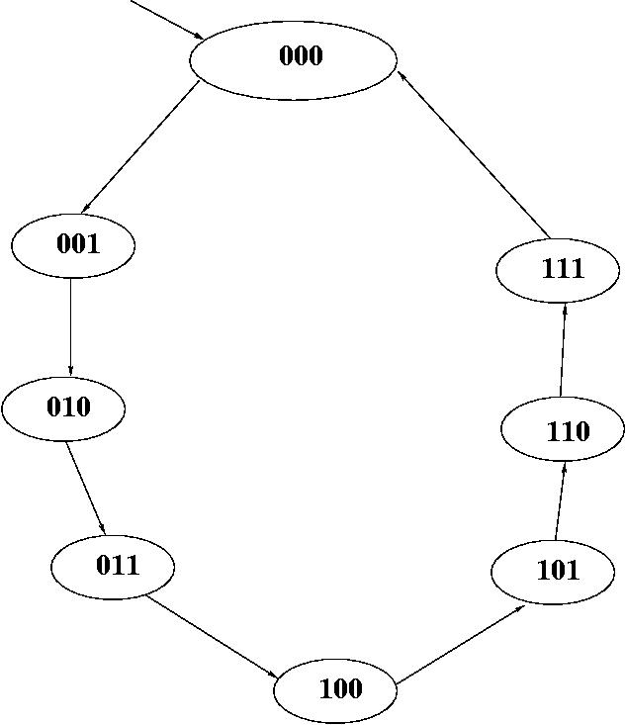
A Simple Example
3 bit counter
C – count signal for increments
Resets to 0 when counter reaches maximum value
Counter can be described by a program with a counter variable (Software Model)
Or in detail using flip flops, gates and wires (Hardware model)

Slide 39
State Machine Model
Counter behaviour naturally described by a state machine
States determine the current value of the counter
Transitions model state changes to the event C.
Initial state determines the initial value of the counter
No final state (why?)

Slide 40
Precise Definition
< Q, q0, S, T>
Q – A finite no. of state names
q0 – Initial state
S – Edge alphabet
  Abstract labels to concrete event, condition and action
T – edge function or relation

Slide 41
Semantics
Given the syntax, a precise semantics can be defined
Set of all possible sequences of states and edges
Each sequence starts with the initial state
Every state-edge-state triples are adjacent states connected by an edge
Given a FSM, a unique set of sequences can be associated
Language accepted by a FSM

Slide 42
Abstract Models
Finite State machine model is abstract
Abstracts out various details
  How to read inputs?
  How often to look for inputs?
  How to represent states and transitions?
  Focus on specific aspects
Easy for analysis, debugging
Redesign cost is reduced
Different possible implementations
  Hardware or Software
  Useful for codesign of systems

Slide 43
Intuitive Models
FSM models are intuitive
Visual
  A picture is worth a thousand words
Fewer primitives – easy to learn, less scope for mistakes and confusion
Neutral and hence universal applicability
  For Software, hardware and control engineers

Slide 44
Rigorous Models
FSM models are precise and unambiguous
Have rigorous semantics
Can be executed (or simulated)
Execution mechanism is simple: An iterative scheme
  state = initial_state
  loop
  case state:
  state 1: Action 1
  state 2: Action 2
  . . .
  end case
  end

Slide 45
Code Generation
FSM models can be refined to different implementation
  Both HW and SW implementation
  Exploring alternate implementations
  For performance and other considerations
Automatic code generation
Preferable over hand generated code
Quality is high and uniform

Slide 46
States and Transitions
Many Flavors of State Machines
  edge labeled - Mealy machines
  state labeled - Kripke structures
  state and edge labeled - Moore machines
  Labels
    Boolean combination of input signals and outputs
    communication events (CSP, Promela)

Slide 47
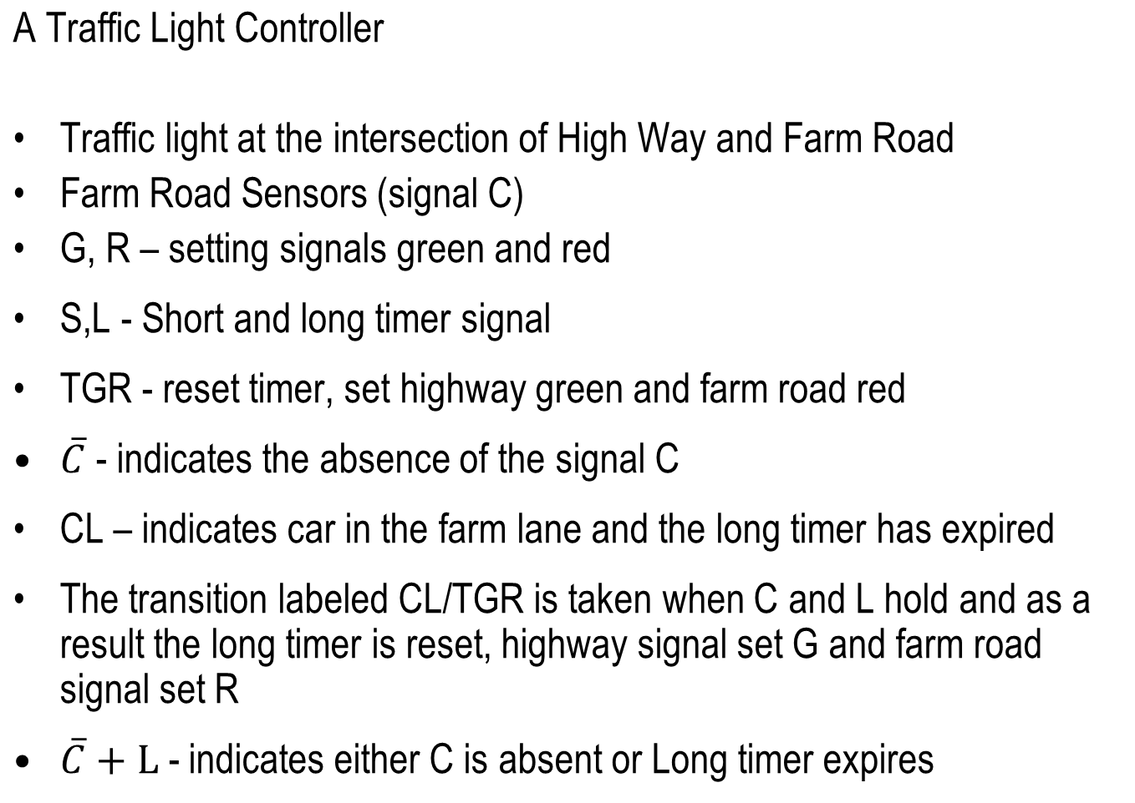
Another Example

Slide 48
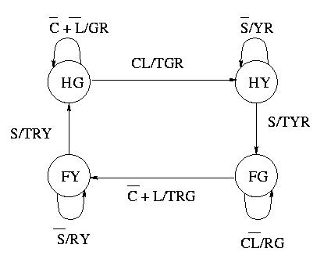
State Machine

Slide 49
Another Example
A Simple Lift Controller
3-floor lift
Lift can be in any floor
  S_{i} - in floor I
Request can come from any floor
  ri - request from floor I
Lift can be asked to move up or down
  uj,dj - up/down to jth floor

Slide 50
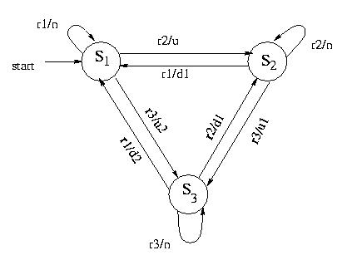
FSM model

Slide 51
Nondeterminism
Suppose lift is in floor 2 (State S ₂ )
What is the next state when when requests r1 and r3 arrive?
  Go to S₁
  Or go to S₃
The model non committal – allows both
More than one next state for a state and an input
This is called nondeterminism
Nondeterminism arises out of abstraction
Algorithm to decide the floor is not modeled
Models can be nondeterministic but not real lifts!

Slide 52
Nondeterminism
Models focus attention on a particular aspect
The lift model focussed on safety aspects
And so ignored the decision algorithm
  Modeling languages should be expressive
  Std. Programming languages are not
Use another model for capturing decision algorithm
Multiple models, separation of concerns
  Independent analysis and debugging
  Management of complexity
Of course, there should be a way of combining different models

Slide 53
C-model
enum floors {f1, f2, f3};
enum State {first, second, third};
enum bool {ff, tt};
enum floors req, dest;
enum bool up, down = ff;
enum State cur_floor = first;
req = read_req();
while (1)
{ switch (cur_floor)
{ case first: if (req == f2)
{up = tt; dest = f2;}
else if (req == f3)
{up = tt; dest = f3;}
else { up == ff; down = ff;};
break;

Slide 54
C- model
case second: if (req == f3)
{up = tt; dest = f3;}
else if (req == f1)
{ up = ff; down = tt; dest = f1;}
else { up == ff; down = ff;};
break;
case third: if (req == f2)
{up = ff; down = tt; dest = f2;}
else if (req == f1)
{ up = ff; down = tt; dest = f1;}
else { up == ff; down = ff;};
break; }; /* end of switch */
req = read_req(); } /* end of while */

Slide 55
Suitability of C
C not natural for such applications
Various problems
  Events and states all modeled as variables
  Not natural for even oriented embedded applications
  States are implicit (control points decide the states)
  No abstract description possible
  Commitment to details at an early stage
  Too much of work when the design is likely to be discarded

Slide 56
Exercise
Is the C model non-deterministic?
What happens when two requests to go in different directions arrive at a state?

Slide 57
Yet Another example
A Simple Thermostat controller
T > tmax
off
on
T’ = K1
T’ = K2
T < tmin

Slide 58
Summary
Finite number of states
Initial state
No final state (reactive system)
Non determinism (result of abstraction)
Edges labeled with events
Behavior defined by sequences of transitions
Rigorous semantics
Easy to simulate and debug
Automatic Code generation

Slide 59
Problems with FSMs
All is not well with FSMs
FSMs fine for small systems (10s of states)
Imagine FSM with 100s and 1000s of states which is a reality
Such large descriptions difficult to understand
FSMs are flat and no structure
Inflexible to add additional functionalities
Need for structuring and combining different state machines

Slide 60
Statecharts
Extension of FSMs to have these features
Due to David Harel
Retains the nice features
  Pictorial appeal
  States and transitions
enriched with two features
  Hierarchy and Concurrency
States are of two kinds
  OR state (Hierarchy)
  AND state (concurrency)

Slide 61
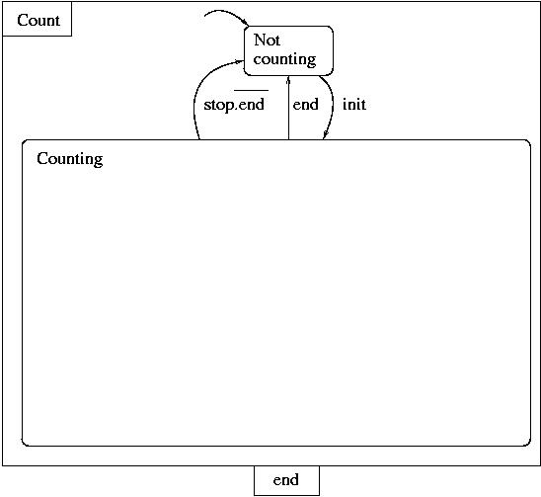
OR States
An OR state can have a whole state machine inside it
Example:

Slide 62
OR states
When the system is in the state Count, it is either in counting or not_counting
exactly in one of the inner states
Hence the term OR states (more precisely XOR state)
When Count is entered, it will enter not_counting
  – default state
Inner states can be OR states (or AND states)

Slide 63
OR states
Both outer and inner states active simultaneously
When the outer state exits, inner states also exited
Priorities of transitions
Preemption (strong and weak)

Slide 64
Economy of Edges
Every transition from outer state corresponds to many transitions from each of the inner states
Hierarchical construct replaces all these into one single transition
Edge labels can be complex

Slide 65
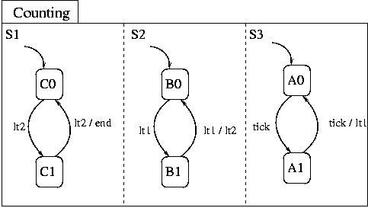
And States
An Or state contains exactly one state machine
An And state contains two or more state machines
Example:

Slide 66
Example
Counting is an And state with three state machines
S1, S2, S3, concurrent components of the state
When in state Counting, control resides simultaneously in all the three state machines
Initially, control is in C0, B0 and A0
Execution involves, in general, simultaneous transitions in all the state machines

Slide 67
Example (contd.)
When in state C0, B1, A2, clock signal triggers the transition to B2 and A2 in S2 and S3
When in C0, B2, A2, clock signal input trigger the transitions to C1, B0 and A0 in all S1, S2, S3
And state captures concurrency
Default states in each concurrent component

Slide 68
Economy of States
An AND-state can be flattened to a single state machine
Will result in exponential number of states and transitions
AND state is a compact and intuitive representation

Slide 69
Counting
What are the three components of the state?
They represent the behaviour of the three bits of a counter
S3 – the least significant bit, S2 the middle one and S1 the most significant bit
Compare this with the flat and monolithic description of counter state machine given earlier
Which is preferable?
The present one is robust - can be redesigned to accommodate additional bits
Look at the complete description of the counter

Slide 70
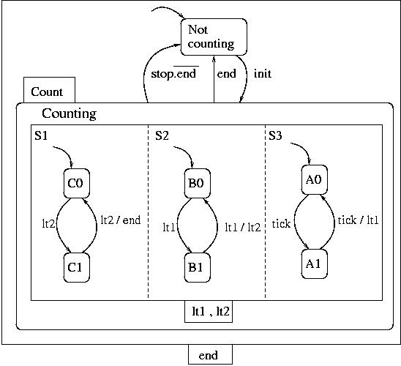
Complete Machine

Slide 71
Communication
Concurrent components of AND state communicate with each other
Taking an edge requires certain events to occur
New signals are generated when an edge is taken
These can trigger further transitions in other components
A series of transitions can be taken as a result of one transition triggered by environment event
Different kinds of communication primitives
More on this later

Slide 72
Flat State Machines
Capture the behaviour of the counter using FSMs
Huge number of states and transitions
Explosion of states and transitions
Statechart description is compact
Easy to understand
Robust
Can be simulated
Code generation is possible
Execution mechanism is more complex

Slide 73
Exercise
Extend the lift controller example
  Control for closing and opening the door
  Control for indicator lamp
  Avoid movement of the lift when the door is open
  Include states to indicate whether the lift is in service or not
  Controller for multiple lifts
Give a statechart description

Slide 74
Extensions to Statecharts
various possibilities explored
adding code to transitions
to states
complex data types and function calls
Combining textual programs with statecharts
Various commercial tools exist
Statemate and Rhapsody (IBM)
UML tools (IBM)
Stateflow (Mathworks)
SynchCharts (Esterel Technologies)

Slide 75
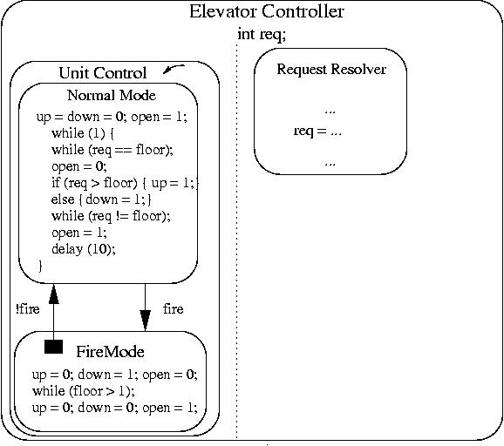
Example
Program State Machine model

Slide 76
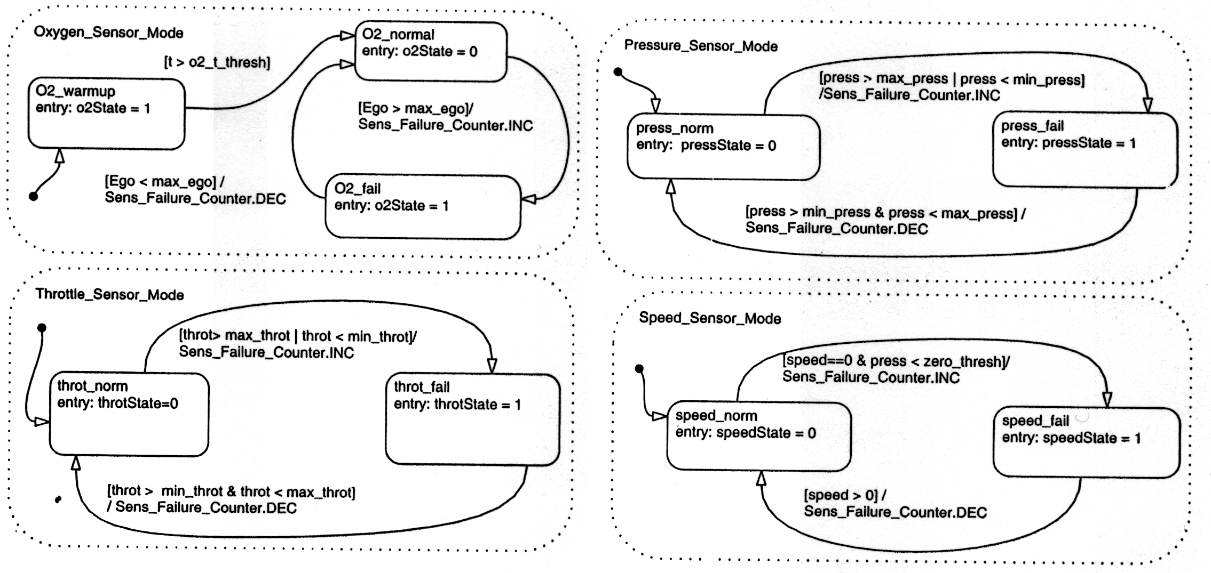
Fuel Controller

Slide 77
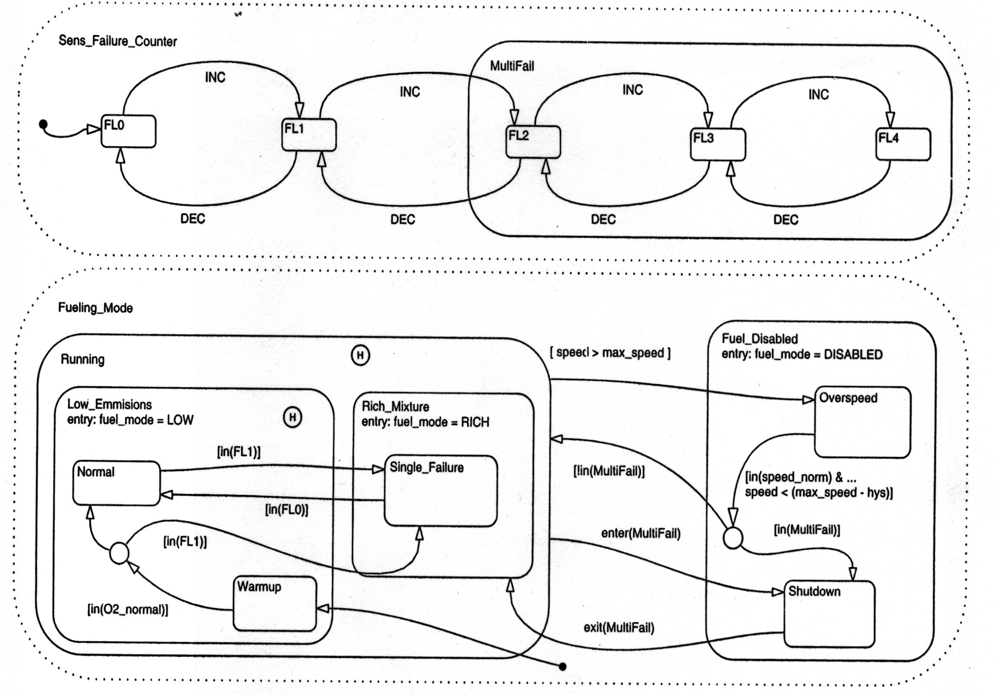
Fuel Controller (Contd.)

Slide 78
More Exercises
Construct the State machine models of
  Critical Section Problem
  Producer-Consumer Problem
  Dining Philosopher Problem
And argue the correctness of solutions
Formal Analysis and Verification (more on this later)

Slide 79
Other Models
Synchronous Reactive Models
  useful for expressing control dominated application
  rich primitives for expressing complex controls
  Esterel (Esterel Technologies)
  More on this later

Slide 80
Design Features
Two broad classifications
  Control-dominated designs
  Data-dominated Designs
Control-dominated designs
  Input events arrive at irregular and unpredictable times
  Time of arrival and response more crucial than values

Slide 81
Design Features
Data-dominated designs
  Inputs are streams of data coming at regular intervals (sampled data)
  Values are more crucial
  Outputs are complex mathematical functions of inputs
  numerical computations and digital signal processing computations

Slide 82
Data flow Models
State machines, Statecharts, Esterel are good for control-dominated designs
Date flow models are useful for data-dominated systems
Special case of concurrent process models
System behaviour described as an interconnection of nodes
Each node describes transformation of data
Connection between a pair of nodes describes the flow of data between from one node to the other

Slide 83
Data Flow Models
Graphical Languages with support for
  Simulation, debugging, analyisis
  Code generation onto DSP and micro processors
Analysis support for hardware-software partitioning
Many commercial tools and languages
  Lustre, Signal
  SCADE
  Simulink

Slide 84
Data Flow Models
Different way of looking at Computations
Computations triggered by availability of data
Contrast with Sequential Control Model
Inherently Parallel Execution
Natural for Signal Processing and Continuous Control Applications
Kahn Networks – Fundamental model

Slide 85
Kahn Networks
Process 1
Process 2
FIFO
FIFO
FIFO
Process 3

Slide 86
Example
A
B
C
D
A
B
C
D
+
-
modulate
convolve
t1
t2
t1
t2
Transform
*
B
B

Slide 87
Execution
Each Process executes independently
Execution involves:
  Read – Compute- Write cycle
Reading `consumes’ the data from the inputs FIFO
Writing adds data to the output FIFO
unbounded FIFO assumed in geneal
Process code sequential – any imperative language suffices

Slide 88
Scheduling
When different processes executed?
What happens to `read’ when there is no data?
What happens when there is no space in the output FIFO?
Which channels to read first?
Appropriate process scheduling required
Data-driven and Demand driven execution models
Nondeterministic results

Slide 89
Kahn Networks
Deterministic processes
Reading an empty channel blocks the process
So read operation is called `wait’
Simultaneous `waits’ on multiple channels not possible
Emptiness check on FIFO not allowed
Each process is a C-like function augmented with `wait’ and `write’ operations

Slide 90
An example (from Kahn ‘74)
Process f(in int u, in int v, out int w)
{ int i, bool b = true;
for (;;) { i = if (b) then wait(u) else wait(v);
printf(“%i\n”,i);
send(i,w); b = !b
}
}
u
f
w
v

Slide 91
Another Example
process g(in int u, out int v, out int w)
{ int i; bool b = true;
for(;;) { i = wait(u);
if (b) send(i, v); else send(i,w);
b = !b;}
}
v
g
u
w

Slide 92
Process Networks
Emits a 1 then copies input to output
h1
g
f
h2
Emits a 0 then copies input to output

Slide 93
Scheduling
Careful scheduling needed
Schedule different nodes so that no unbounded accumulation of tokens in the FIFO
Different scheduling possible
All schedules are equivalent
Whether a Kahn network can execute in bounded memory is undecidable
Deadlocking can happen – again it is undecidable whether a network is deadlocking

Slide 94
Synchronous Data Flow Models
SDF (Edward Lee ’87)
Restriction of KPN to compile-time scheduling
Each time a block fires, it reads a fixed no. of reads/write from/to its I/O Channels
Natural for multi-rate Signal processing

Slide 95
Data Flow Equations
p
m
n
n
q
A
B
A reads p tokens, produces m tokens
B, reads n tokens, produces q tokens
If N1 and N2 are the number of firings of A and B, after which no tokens in the FIFO,
N1*m = N2*n

Slide 96
System of Equations
In General, each edge would define an equation
No hanging I/O channels – Source and destinations are modeled as nodes
An SDF would correspond to a system of equations
Each solution corresponds to a schedule of block executions
Multiple solutions possible,
No solution may exist – deadlocking
Least positive integer solution defines an ideal schedule
  Why positive solution?

Slide 97
Examples
Model 1: Schedule exists:
  Equations:
  a = b
  2a = c
  2b = c
  Does a solution exist?
  Least positive solution:
  a = b = 1, c =2
  The schedule is:
  A; B; C; C; A;B; C; C; . . .
Model 2: Is there a schedule?
  Equations:
  a =b, 2a = c, b = c
Model 1
1
B
2
1
1
A
C
2
1
Model 2
1
1
B
1
1
A
C
2
1

Slide 98
SDF Scheduling
Involves forming the equations
Obtaining the least positive integer solutions which gives the schedule
The equations may be inconsistent in which no schedule possible
There exist an algorithm which can check consistency of equations and obtain a schedule if they are
  Foundation of the SDF compiler/scheduler
Deadlocking still possible – consistency can not guarantee this
  Algorithm for checking deadlocking exist

Slide 99
Discrete Event Models
Used for HW systems
VHDL, Verilog
Models are interconnection of nodes or agents
Each node reacts to events at their inputs
Generates output events which trigger other nodes

Slide 100
DE Models
External events initiates a reaction
Events are time stamped and stored in an time ordered event queue
Delays in nodes modeled as delays in event generation
Simulation
Problems with cycles
Delta cycles in VHDL

Slide 101
Discrete Event Models
C
A
B
D

Slide 102
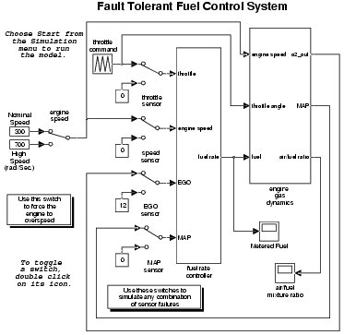

Slide 103
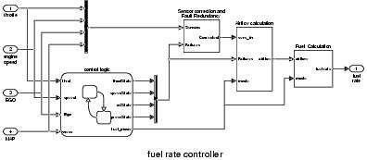

Slide 104
Summary
Various models reviewed
  Sequential programming models
  Hierarchical and Concurrent State Machines
  Data Flow Models, Discrete Event Models
Each model suitable for particular applications
State Machines for event-oriented control systems

Slide 105
Summary
Sequential program model, data flow model for function computation
Real systems often require mixture of models
Modeling tools and languages should have combination of all the features
  Ptolemy (Berkeley)

Slide 106
References
embedded.eecs.berkeley.edu/metropolis/index.html
ptolemy.eecs.berkeley.edu/ptolemyII/index.htm
N. Halbwachs, Synchronus Programming Of Reactive Systems, Kluwer, 1993
D. Harel et al., STATEMATE: a working environment for the development of complex reactive systems, IEEE Trans. Software Engineering, Vol. 16 (4), 1990.
www.mathworks.com/simulink
http://www.omg.org/spec/UML/2.5/

